Slide 1

Cloud Security and Forensics
Virtualization
Dr. Raj K Jaiswal

Slide 2
Full Virtualization
Virtualization is the simulation of the software and/or hardware upon which other software runs.
This simulated environment is called a virtual machine (VM).
There are many forms of virtualization, distinguished primarily by computing architecture layer.
For example, application virtualization provides a virtual implementation of the application programming interface (API) that a running application expects to use, allowing applications developed for one platform to run on another without modifying the application itself.
The Java Virtual Machine (JVM) is an example of application virtualization; it acts as an intermediary between the Java application code and the operating system (OS).
Another form of virtualization, known as operating system virtualization, provides a virtual implementation of the OS interface that can be used to run applications written for the same OS as the host, with each application in a separate VM container.

Slide 3
Full Virtualization
In full virtualization, one or more OSs and the applications they contain are run on top of virtual hardware.
Each instance of an OS and its applications runs in a separate VM called a guest operating system.
The guest OSs on a host are managed by the hypervisor, also called the virtual machine monitor (VMM).
It controls the flow of instructions between the guest OSs and the physical hardware, such as CPU, disk storage, memory, and network interface cards.
The hypervisor can partition the system’s resources and isolate the guest OSs so that each has access to only its own resources, as well as possible access to shared resources such as files on the host OS.

Slide 4
Full Virtualization
There are two forms of full virtualization.
Bare metal virtualization, also known as native virtualization, the hypervisor runs directly on the underlying hardware, without a host OS.
The hypervisor can even be built into the computer’s firmware.
In the other form of full virtualization, known as hosted virtualization, the hypervisor runs on top of the host OS.
The host OS can be almost any common operating system such as Windows, Linux, or MacOS.
Hosted virtualization architectures usually also have an additional layer of software (the virtualization application) running in the guest OS that provides utilities to control the virtualization while in the guest OS, such as the ability to share files with the host OS.

Slide 5
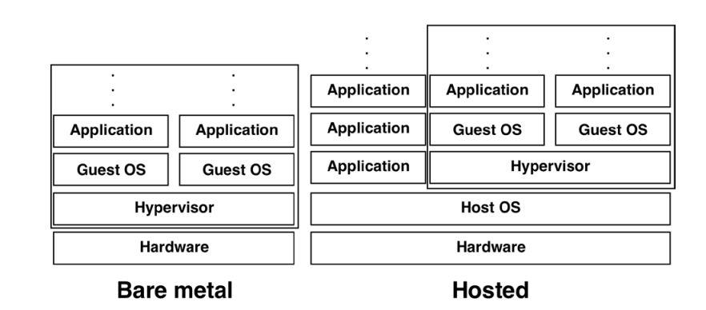
Full Virtualization
Hosted virtualization architectures also allow users to run applications such as web browsers and email clients alongside the hosted virtualization application.
Unlike bare metal architectures, which can only run applications within virtualized systems.
Servers are most often virtualized on computers using bare metal virtualization. Desktops are most often virtualized on computers with hosted virtualization.
In both bare metal and hosted virtualization, each guest OS appears to have its own hardware, like a regular computer.
Figure: Full Virtualization

Slide 6
Full Virtualization
Choosing bare metal virtualization by replacing a host OS with a hypervisor may improve security.
However, it depends on how well-secured the hypervisor is.
While adding a hypervisor on top of a host OS tends to increase risk

Slide 7
Paravirtualization
Paravirtualization is a type of virtualization where software instructions from the guest operating system running inside a virtual machine.
It can use “hypercalls” that communicate directly with the hypervisor.
Examples of Paravirtualization
VMware ESXi hypervisor
Xen open-source hypervisor
Oracle VM VirtualBox hypervisor
QNX® Hypervisor

Slide 8
Partial Virtualization
Virtualization technique used to implement a certain kind of virtual machine environment
Provides only a partial simulation of the underlying hardware
Most but not all of the hardware features are simulated
Usually, this means that entire operating systems cannot run in the virtual machine but that many applications can run.
A key form of partial virtualization is "address space virtualization", in which each virtual machine consists of an independent address space
Partial virtualization was an important historical milestone on the way to full virtualization
It was used in the first-generation time-sharing system CTSS, and in the IBM M44/44X experimental paging system

Slide 9
Virtualization Layers
The virtualization software creates the abstraction of VMs by interposing a virtualization layer at various levels of a computer system.
Common virtualization layers include:
The instruction set architecture (ISA) level,
Hardware level,
Operating system level,
Library support level, and
Application level

Slide 10
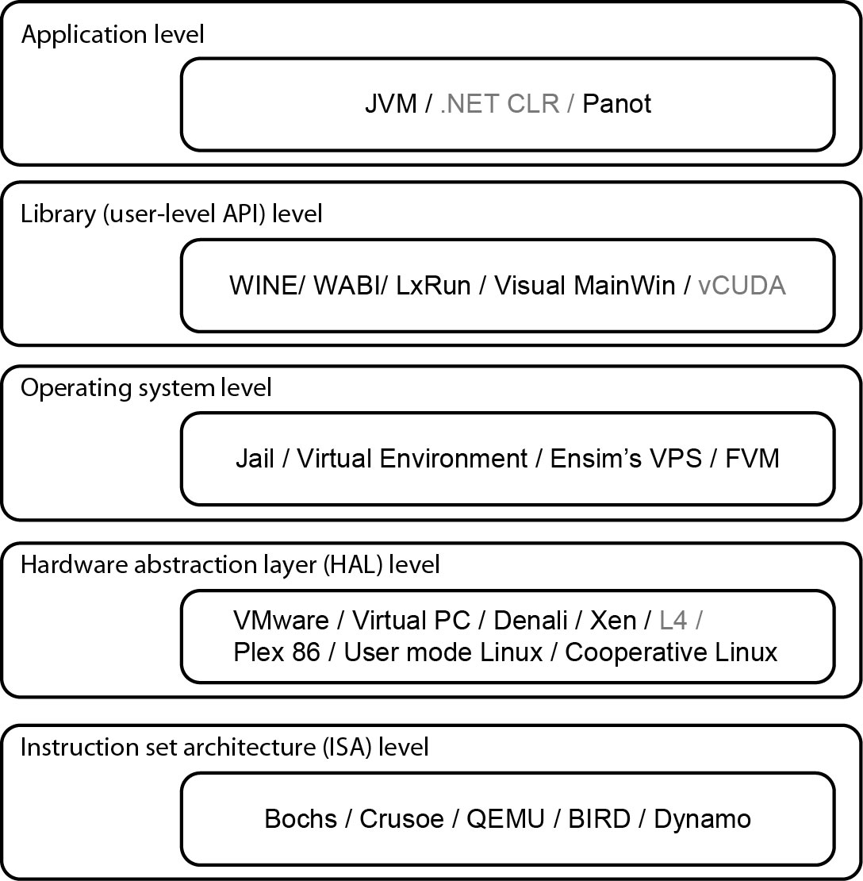
Virtualization Abstraction Layers from Hardware to Application

Slide 11
Virtualization at Instruction set architecture (ISA) level
At the ISA level, virtualization is performed by emulating a given ISA by the ISA of the host machine. Instruction set emulation leads to virtual ISAs created on any hardware machine. e.g, MIPS binary code can run on an x-86-based host machine with the help of ISA emulation.
With this approach, it is possible to run a large amount of legacy binary code written for various processors on any given new hardware host machine.
code interpretation – dynamic binary translation - virtual instruction set architecture (V-ISA)
Advantage:
It can run a large amount of legacy binary codes written for various processors on any given new hardware host machines
best application flexibility
Shortcoming & limitation:
One source instruction may require tens or hundreds of native target instructions to perform its function, which is relatively slow.
V-ISA requires adding a processor-specific software translation layer in the complier.

Slide 12
Virtualization at Hardware Abstraction level
Hardware-level virtualization is performed right on top of the bare hardware.
On the one hand, this approach generates a virtual hardware environment for a VM.
On the other hand, the process manages the underlying hardware through virtualization.
The idea is to virtualize a computer’s resources, such as its processors, memory and I/O devices. The intention is to upgrade the hardware utilization rate by multiple users concurrently.
Advantage:
Has higher performance and good application isolation
Shortcoming & limitation:
Very expensive to implement (complexity)

Slide 13
Virtualization at Operating System level
OS-level virtualization creates isolated containers on a single physical server and the OS instances to utilize the hardware and software in data centers. The containers behave like real servers.
OS-level virtualization is commonly used in creating virtual hosting environments to allocate hardware resources among a large number of mutually distrusting users.
Advantage:
Has minimal startup/shutdown cost, low resource requirement, and high scalability; synchronize VM and host state changes.
Shortcoming & limitation:
All VMs at the operating system level must have the same kind of guest OS
Poor application flexibility and isolation.

Slide 14
Virtualization at Operating System level

Slide 15
Virtualization at Library Support level
Since most systems provide well-documented APIs, such an interface becomes another candidate for virtualization.
Virtualization with library interfaces is possible by controlling the communication link between applications and the rest of a system through API hooks.
The software tool WINE has implemented this approach to support Windows applications on top of UNIX hosts.
Another example is the vCUDA which allows applications executing within VMs to leverage GPU hardware acceleration.
Advantage:
It has very low implementation effort
Shortcoming & limitation:
poor application flexibility and isolation

Slide 16
User Application level
Virtualization at the application level virtualizes an application as a VM. On a traditional OS, an application often runs as a process.
Therefore, application-level virtualization is also known as process-level virtualization.
The most popular approach is to deploy high level language (HLL) VMs. In this scenario, the virtualization layer sits as an application program on top of the operating system, and the layer exports an abstraction of a VM that can run programs written and compiled to a particular abstract machine definition.
Other forms of application-level virtualization are known as application isolation, application sandboxing, or application streaming.
Advantage:
has the best application isolation
Shortcoming & limitation:
low performance, low application flexibility and high implementation complexity.

Slide 17
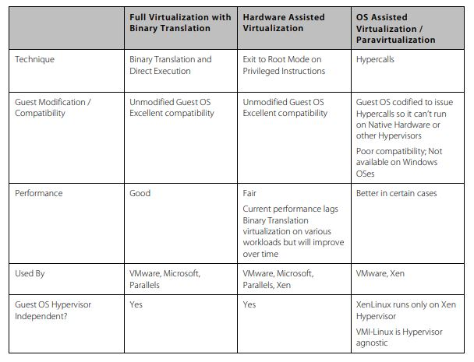
Paravirtualization

